Slide 1

Computer Networks
MO-IT104 - S2101
Abdullah Alhadad
Richard Catorce
MO-IT104 Computer Networks
Notes:
“Good day everyone. We are presenting our final network design for MotorPH. This network was developed to support multiple departments, enable secure communication, and provide a scalable foundation for future expansion.”

Slide 2


All course materials, including lectures, class recordings, presentations, handouts, assignments, and assessments, are the exclusive property of Mapua-Malayan Digital College and are protected under Republic Act No. 8293, also known as the Intellectual Property Code of the Philippines (IP Code).
Unauthorized downloading, copying, reproduction, distribution, or uploading of any part or whole of this material, in any form or medium, is strictly prohibited. Such actions constitute copyright infringement under Sections 172, 177, and 216 of the IP Code and may result in legal consequences.
For permissions or inquiries, please contact MMDC-ISD at isd@mmdc.mcl.edu.ph.
Proprietary Notice
MO-IT104 Computer Networks

Slide 3

Decision-Making Process
Solution Verification and Testing
Lessons Learned & Mitigation: VLAN Setup
MotorPH Connectivity
MO-IT104 Computer Networks

Slide 4
Executive Summary
This presentation outlines the final network solution designed for MotorPH’s multi-department headquarters. The network uses a Layer 3 switched Core–Access architecture and a hierarchical star topology to ensure high performance, scalability, and simplified management. Departmental segmentation using VLANs improves security and reduces broadcast traffic, while inter-VLAN routing on the Core Switch enables efficient communication between teams. The solution is fully tested in Packet Tracer, demonstrating reliable IP addressing, DHCP allocation, trunking, and inter-VLAN connectivity.
MO-IT104 Computer Networks
Notes:
“This project demonstrates a complete end-to-end network design using a Core–Access architecture.
We implemented VLAN segmentation for security, a Layer 3 Core Switch for inter-VLAN routing, and a structured hierarchical layout to maintain performance and manageability.
The final network has been fully tested in Packet Tracer, and all connectivity requirements were met.”

Slide 5
Introduction
As MotorPH continues to expand its operations and enhance its technological infrastructure, a reliable and well-structured network becomes essential to support its growing business demands. This document outlines the network requirements and design plan for the next 12 weeks, focusing on creating a secure, scalable, and efficient network architecture for MotorPH’s new headquarters.
The goal is to ensure seamless communication, optimized performance, and future readiness by carefully planning each aspect of the network — from topology and device selection to IP addressing and risk management. Using Cisco Packet Tracer, the proposed design will be simulated and tested to verify its functionality and compliance with Campus Architecture standards.
In addition to the design and implementation simulation, this document also provides troubleshooting procedures, risk reduction policies, and comprehensive documentation to ensure smooth deployment, maintenance, and long-term reliability of MotorPH’s network infrastructure.
MO-IT104 Computer Networks
Notes:
“This project demonstrates a complete end-to-end network design using a Core–Access architecture.
We implemented VLAN segmentation for security, a Layer 3 Core Switch for inter-VLAN routing, and a structured hierarchical layout to maintain performance and manageability.
The final network has been fully tested in Packet Tracer, and all connectivity requirements were met.”

Slide 6

Decision-Making Process
Network Design Rationale
Key Considerations:
Multiple departments require segmentation for organization and security.
Departments must still communicate when authorized.
The network must scale for future expansion.
Design Choice: Layer 3 Core–Access Architecture Why:
Option | Result
Router-on-a-Stick | Introduces bandwidth bottleneck / slower routing
Layer 3 Switching (Selected) | Inter-VLAN routing occurs at wire-speed, scalable, simpler to manage
MO-IT104 Computer Networks
Notes:
“We selected a Layer 3 switched design because the organization needs both segmentation and controlled connectivity.
Scalability, performance, and future growth were key considerations.
VLANs isolate departments, and the Core Switch acts as the routing point, so communication only occurs where allowed.”

Slide 7

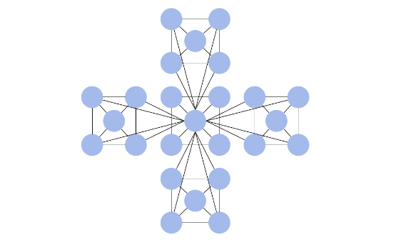
Architectural Overview
Model: Hierarchical Star Topology
The network employs an extended star (or hierarchical) topology. All end devices connect to an access-layer switch, and all access-layer switches connect to a central core switch.
This design is highly scalable, easy to troubleshoot, and provides high performance by isolating traffic domains.
Notes:
“We used a hierarchical star topology.
All end devices connect to departmental Access Switches, and those switches connect to the Core Switch.
This makes the network easier to expand and troubleshoot, because each department is handled as a separate block.”

Slide 8
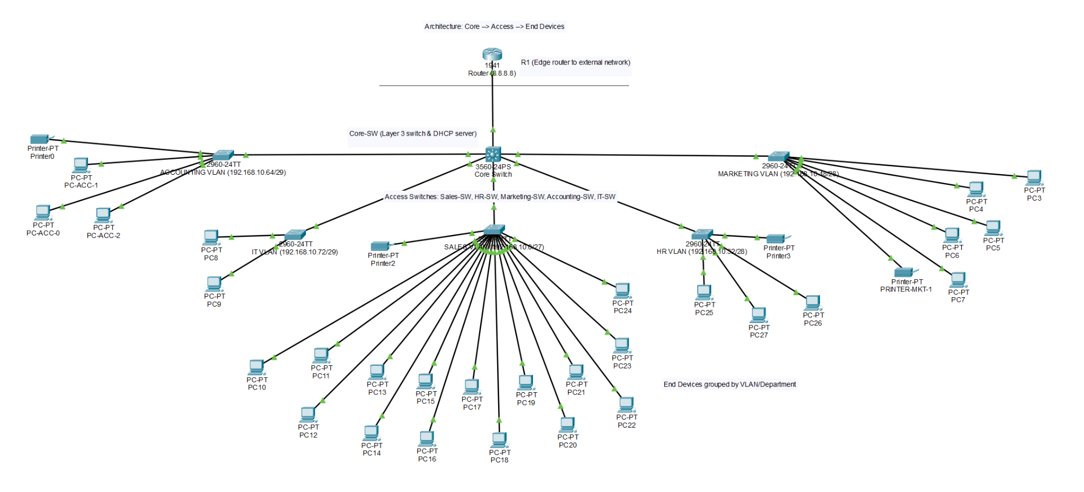
Network Architecture: Final Solution
An analysis of the proposed network infrastructure.
Key Components:
Core-SW (Layer 3 switch & DHCP server)
R1 (Edge router to external network)
Access Switches: Sales-SW, HR-SW, Marketing-SW, Accounting-SW, IT-SW
End Devices grouped by VLAN/Department
Architecture: Core → Access → End Devices
MO-IT104 Computer Networks
Notes:
“Here we can see the main components.
The Core Switch provides routing and DHCP services.
The Access Switches provide device connectivity, and the Edge Router is responsible for external connectivity.”

Slide 9


Core Network Components
1. Multilayer Core Switch (L3)
2. WAN Gateway Router
The backbone of the network. This Layer 3 switch handles high-speed data switching and inter-VLAN routing, eliminating the need for a separate internal router and reducing bottlenecks.
The primary router connects the entire internal network to the Internet. It acts as the secure gateway for all external traffic and the single point of entry and exit for the network.
MO-IT104 Computer Networks
Notes:
“The Core Switch handles routing between VLANs.
The Router acts as the main gateway for traffic leaving the network.
This division allows internal routing to stay fast and hardware-based, while WAN routing is controlled and secured.”

Slide 10
VLAN & IP Addressing Scheme
Department | VLAN ID | Network | SVI Gateway | DHCP Scope
Sales | 100 | 192.168.10.0/27 | 192.168.10.1 | Yes
HR | 103 | 192.168.10.32/28 | 192.168.10.33 | Yes
Marketing | 104 | 192.168.10.48/28 | 192.168.10.49 | Yes
Accounting | 106 | 192.168.10.64/29 | 192.168.10.65 | Yes
IT | 107 | 192.168.10.72/29 | 192.168.10.73 | Yes
WAN Link | N/A | 192.168.1.0/30 | Core-SW: 192.168.1.1 → R1: 192.168.1.2 | N/A
MO-IT104 Computer Networks
Notes:
“Each department is assigned its own VLAN and subnet.
This reduces broadcast traffic and keeps departmental traffic separated.
Inter-VLAN routing happens at the Core Switch using SVIs, allowing authorized inter-department communication.”

Slide 11
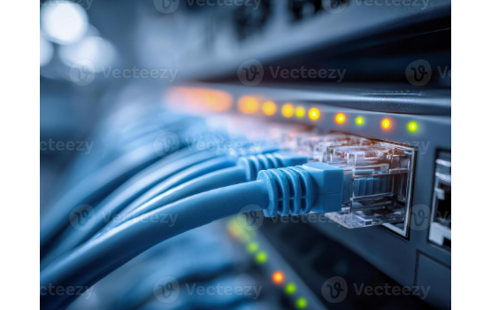
Access Layer & Segmentation
The access layer is where end-user devices connect to the network.
•
Access Switches: Connects end-user devices such as PCs and printers. Each department uses a dedicated Access Switch (e.g., SALES-SW, HR-SW) to organize and manage connections.
•
Departmental Isolation: VLANs provide logical segmentation, ensuring each department has isolated network traffic and its own subnet.
•
Local intra-department traffic (devices within the same VLAN): Stays within the Access Switch, reducing load on the Core, while inter-department traffic is routed by the Core Switch.
MO-IT104 Computer Networks
Notes:
“Each department has its own Access Switch.
Devices within the same VLAN communicate locally at Layer 2.
Only when communication is needed across departments does traffic go to the Core Layer 3 switch.
This reduces unnecessary load and improves performance.”

Slide 12






The Power of Segmentation: VLANs
This architecture is built to support Virtual LANs (VLANs). The departmental switches ("Accounting", "HR", "IT") correspond to separate VLANs, which provides three key advantages:
Enhanced Security
Improved Performance
Simplified Management
Isolates sensitive data (e.g., Accounting) from other departments. A breach in one segment is contained and cannot easily spread.
Reduces broadcast traffic across the entire network. Broadcasts are confined to their own VLAN, freeing up bandwidth.
Allows for easier application of security policies and network rules on a per-department basis from the central core switch.
MO-IT104 Computer Networks
Notes:
“VLAN segmentation provides security by restricting traffic, improves performance by containing broadcasts, and simplifies network policy management.
We can apply rules per department from the Core instead of configuring individual devices.”

Slide 13






Key Network Services
Decentralized Printing
Internet & WAN Access
Centralized DHCP Service
Printers are directly connected to their departmental access switches for local, direct printing access.
Secure, managed internet access is provided to all segments via the central WAN router.
The Core Layer 3 Switch automatically assigns IP addresses to all devices across VLANs, simplifying device setup and network expansion.
MO-IT104 Computer Networks
Notes:
“Printers remain local to each department for convenience.
Internet access is centralized and controlled through the Edge Router.
The Core Switch runs DHCP, allowing devices to auto-configure their IP addresses with no manual setup required.”

Slide 14
Analysis: Strengths of this Solution
Scalability: Easily add new departments or more users by simply adding a new access switch to the core. The hierarchical design scales cleanly.
Performance: The switched, segmented design minimizes congestion and provides high-speed pathways from end-to-end.
Manageability: The hierarchical model is logical and easy to troubleshoot. Problems are isolated to their specific segment.
Security: The foundation for a secure environment is built-in via VLAN segmentation, which is a modern security best practice.
MO-IT104 Computer Networks
Notes:
“The solution grows smoothly by adding switches or devices.
Performance is stable due to traffic segmentation.
Troubleshooting is simplified because issues stay contained to one VLAN or switch.
Security is built-in through logical separation.”

Slide 15

The "Final Solution" Vision
A Resilient & Future-Proof Network
We elevate the initial design from a functional network to a truly resilient, enterprise-grade infrastructure.
This solution establishes a stable foundation that can be expanded into a high-availability network by adding redundancy, security appliances, and monitoring systems in the future.
MO-IT104 Computer Networks
Notes:
“This network is not only functional—it is engineered for future improvements.
We can add redundancy, security appliances, wireless networks, or monitoring systems without redesigning from scratch.”

Slide 16

Solution Verification and Testing

Slide 17


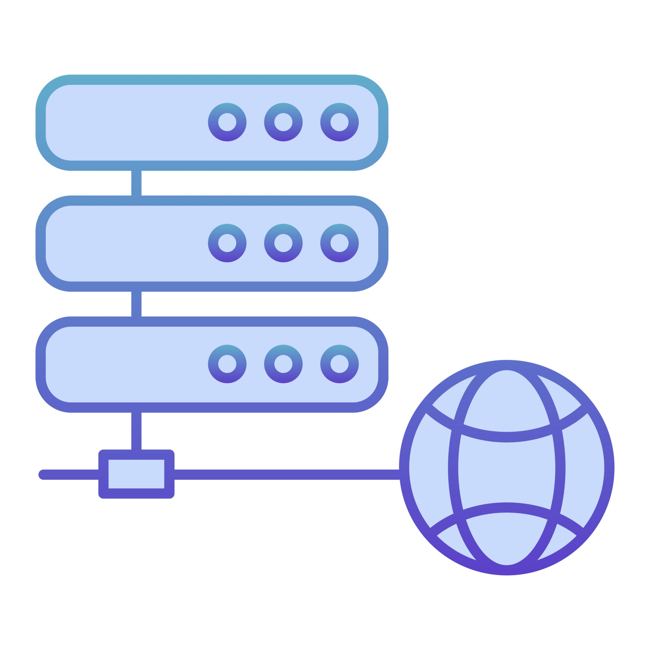
Testing Connectivity
Three key tests were performed to validate the complete data path, all of which were 100% successful.
Local Access (Intra-VLAN)
Routed Access (Inter-VLAN)
Internet Access
Test PC_Accounting 1 pings Printer_Accounting = 0% loss
Test PC_Sales_10 pings PC_IT_8
= 0% loss
Test PC_HR_25 pings Router
= 0% loss
It proves that local Layer 2 switching, port configuration, and VLAN membership are correct within each department.
it proves that Layer 3 Inter-VLAN routing is fully operational on the Multilayer Core Switch. Departments can access each other as permitted.
Proves the Static Default Route is correctly configured, giving all internal devices a path to the internet.
Overall Status: The network is fully converged and 100% reachable, both internally and externally.
MO-IT104 Computer Networks
Notes:
“We validated the network with three key tests:
Local VLAN communication
Inter-VLAN routing
External connectivity through the router All tests resulted in 0% packet loss.”

Slide 18
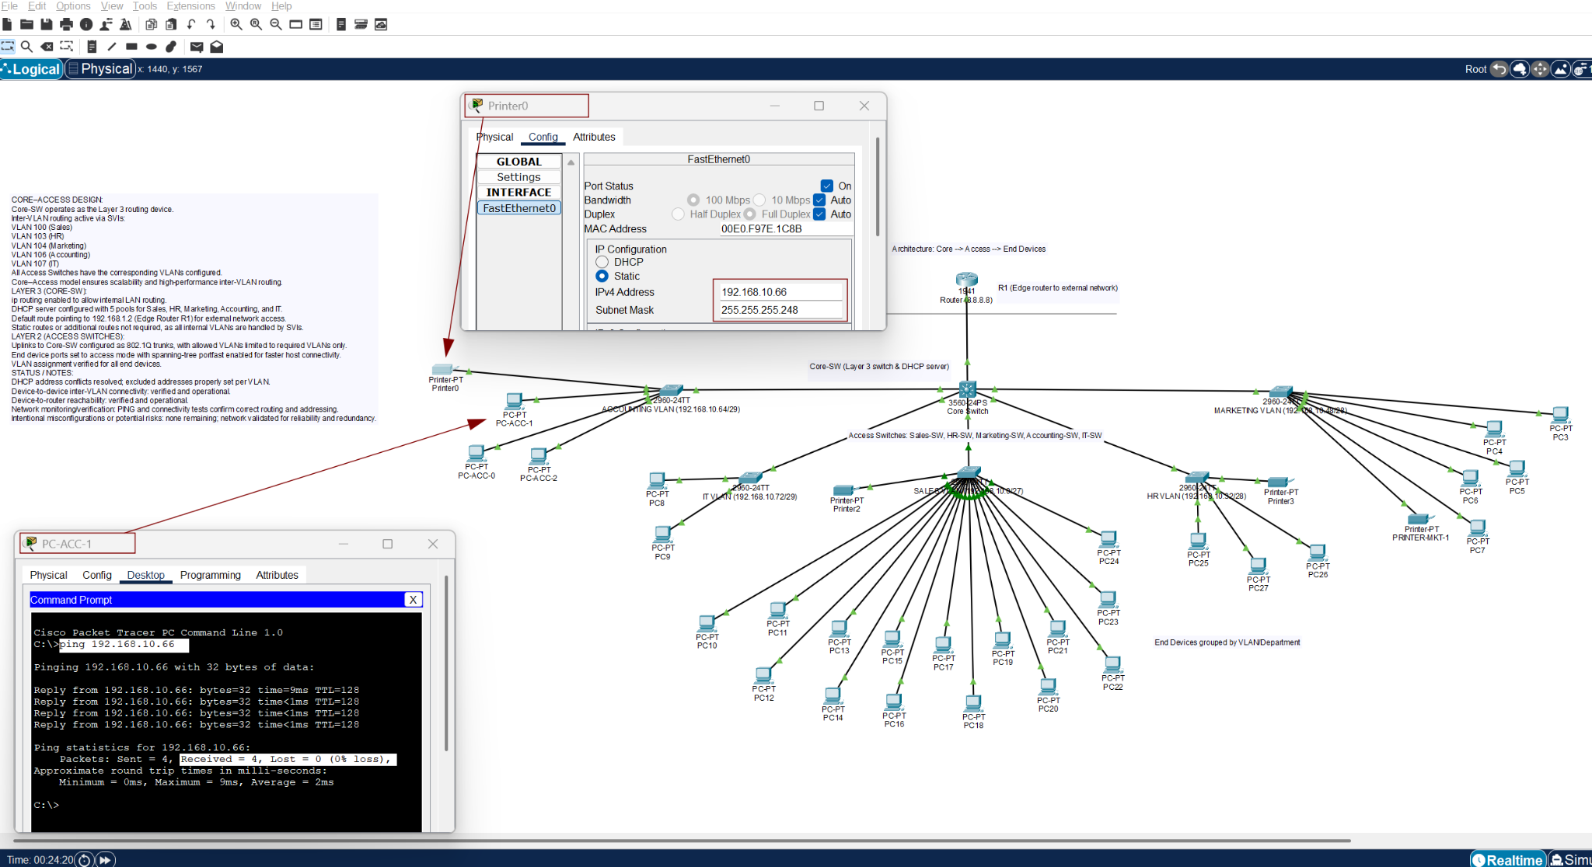
Evidence: Local intra-department connectivity
MO-IT104 Computer Networks
Notes:
“This confirms VLAN membership and switch port configuration were done correctly.”

Slide 19
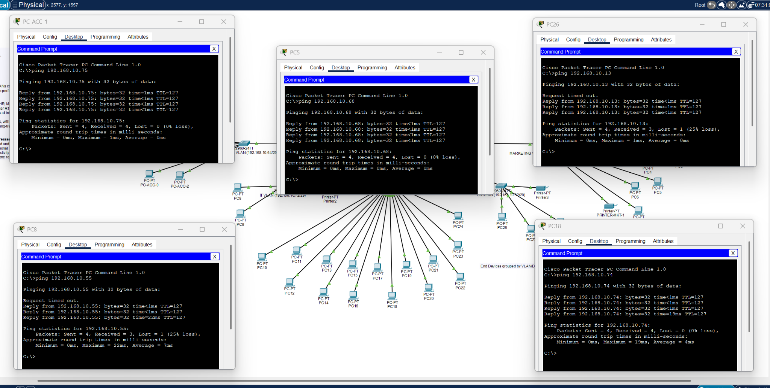
Evidence: Inter-VLAN Connectivity
Explanation: A device in Sales (VLAN 100) successfully communicated with a device in HR (VLAN 103). This verifies:
SVIs are configured correctly.
ip routing is enabled on the Core-SW.
VLAN trunk links are working.
MO-IT104 Computer Networks
Notes:
“This confirms SVIs are correct and ip routing is functioning properly on the Core-SW.”

Slide 20
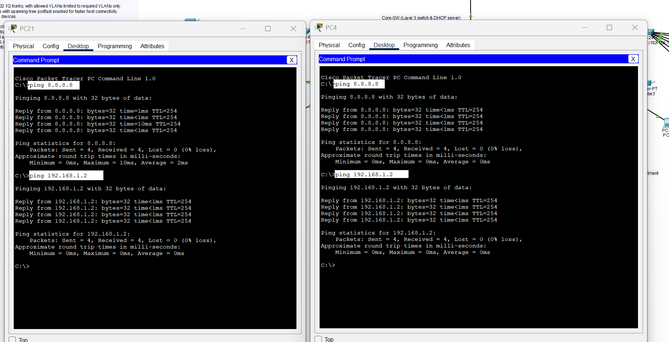
Evidence: External Network Reachability
Explanation: Traffic from internal VLANs is successfully routed through the Core-SW to the edge router (R1). This confirms:
Routing path is valid
Default route is configured correctly
MO-IT104 Computer Networks
Notes:
“This validates our default route configuration and confirms the full routing path to external networks.”

Slide 21
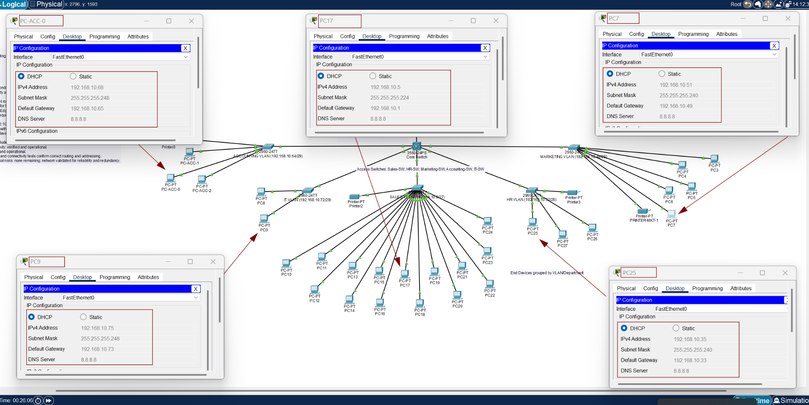
Additional Evidence: DHCP Working
Explanation: Each VLAN receives IP addressing dynamically from the Core-SW DHCP service, confirming:
The VLAN exists on the Access-SW
The Trunk is passing the VLAN to the Core-SW
The correct DHCP pool is applied
Notes:
“Each VLAN successfully receives unique IP assignments from the Core Switch.
This proves the trunks carry VLAN tags correctly and DHCP pools are configured properly.”

Slide 22
Lessons Learned & Mitigation: VLAN Setup
MO-IT104 Computer Networks

Slide 23
Risk Mitigation / Troubleshooting Summary
Issue | Cause | Resolution | Key Indicator / How We Diagnosed It
VLAN Communication Failure | Required VLANs (100, 103, 104, 106, 107) were not created on the Access Switches and uplink ports were still in access mode. | Added VLANs to each Access Switch and set uplinks to switchport mode trunk. | show vlan brief on Access Switch did not list the VLANs → VLAN traffic was being dropped.
DHCP Address Conflicts | DHCP pools overlapped initial static device IPs. | Reserved/excluded static IP addresses and re-issued DHCP leases. | Devices received unexpected IPs / duplicate IP warnings.
Inter-VLAN Routing Failure (Early Stage) | ip routing was not enabled initially on the Core Switch. | Enabled Layer 3 routing with ip routing. | Pings between VLANs timed out until routing was enabled.
External Network Reachability Issue | Missing default static route to Edge Router. | Added ip route 0.0.0.0 0.0.0.0 192.168.1.2. For demo purposes, also added 8.8.8.8 on Loopback. | Pings to Edge Router interface (192.168.1.2) failed before route was set.
MO-IT104 Computer Networks
Notes:
“Most issues came from missing VLAN entries and misconfigured trunk ports.
Using structured troubleshooting allowed us to isolate root causes quickly using show commands such as show vlan brief and show ip route.”

Slide 24
Thank you
Presented by:
Section:
Abdullah Alhadad
MO-IT104 - S2101
Richard Catorce
MO-IT104 Computer Networks
Notes:
“Thank you for listening. “

